Slide 1
Automatic generation of facial behaviors:
from data to evaluation
Alice Delbosc
PHD student LIS
Aix-Marseille University
Stéphane Ayache
Professor LIS
Aix-Marseille University
Magalie Ochs
Associate professor LIS
Aix-Marseille University
Brian Ravenet
Associate Professor LISN
Paris-Saclay University
Nicolas Sabouret
Professor LISN
Paris-Saclay University
JTT TALEP 2023
JTT TALEP 2023

Slide 2
Summary
Why should we care about non-verbal behaviors?
Some challenges related to the nature of gestures
The problem formulation
What system to generate the sequence of behaviors?
Our positioning and progress
Generation of behaviors
Evaluation of behaviors
Conclusion
JTT TALEP 2023
JTT TALEP 2023

Slide 3
Why should we care about non-verbal behaviors?
Gesture plays at least three main functions:
Helping virtual agents and robots appear more alive and engaging
Communicate functional information (pointing gestures, emblems that replace words, metaphorical gestures....)
Communicate social information, including personality or emotions (feelings, emotions and attitudes are often not made explicit verbally and must be inferred from non-verbal channels)
→ The presence of non-verbal communication can radically change the outcome of an exchange
JTT TALEP 2023
JTT TALEP 2023

Slide 4
Some challenges related to the nature of gestures
Growth point hypothesis: gesture and language emerge from a common communicative intention [Mcneill D. “Hand and Mind: What Gestures Reveal about Thought” (1992)]
The gesture is idiosyncratic, different people can make very different gestures
Current approaches synthesize gestures from audio, text or both. Generated gestures will be redundant with other channels, and therefore more limited than actual human gestures
Gestures are synchronized in time with speech and not periodic. Just before speech in about 90% of cases
ACAI 2023
ACAI 2023

Slide 5
Problem formulation
Text input
Audio input
Non-linguistic modalities
Control Input
The two main problems of gesture generation according Neff M. “Hand gesture synthesis for conversational characters” (2016) :
specification problem: determining the gestures to be performed by the agent
animation problem: how to generate the appropriate movement? Pelachaud C. et al. "Embodied contextual agent in information delivering application" (2002)
JTT TALEP 2023
JTT TALEP 2023

Slide 6
What system to generate the sequence of behaviors?
Generative models can be divided into two main categories:
rule-based models
data-based models
In data-based models two sub-categories:
statistical models
learning-based models
In learning-based models two sub-categories:
deterministic approach
non-deterministic approach
JTT TALEP 2023
JTT TALEP 2023

Slide 7
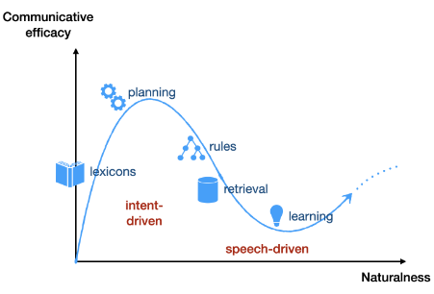
Evolution of generation models (Stefan Kopp)
Early intention-based approaches had high communicative effectiveness but were not very natural, since they mainly inserted predefined animations
Statistical approaches improved the naturalness of gestures, while slightly compromising communicative efficiency
Learning-based models can generate continuous, fairly natural gestures, but are much less communicative
ACAI 2023
ACAI 2023

Slide 8
Our positioning
Generate non-verbal behavior in an interaction situation with a virtual agent, in the context of conflict management in a professional environment:
semantically and rhythmically relevant head movements, gaze and facial expressions
Data-driven non-deterministic approach (to respect stochasticity)
in an interaction context
with a particular social attitude
a hybrid approach if required
JTT TALEP 2023
JTT TALEP 2023

Slide 9
Our work for the first step
Generate non-verbal behavior in an interaction situation with a virtual agent, in the context of conflict management in a professional environment:
rhythmically relevant head movements, gaze and facial expressions
Data-driven non-deterministic approach (to respect stochasticity)
semantically relevant head movements, gaze and facial expressions
in an interaction context
with a particular social attitude
a hybrid approach if required
JTT TALEP 2023
JTT TALEP 2023

Slide 10
Generation of non-verbal behaviour
JTT TALEP 2023
JTT TALEP 2023

Slide 11
Corpora and pre-processing of the data
Dataset Trueness : 36 videos ~3h30
Dataset Cheese : 20 videos ~ 5h
JTT TALEP 2023
JTT TALEP 2023

Slide 12
Data with VS without pre-processing
JTT TALEP 2023
JTT TALEP 2023

Slide 13
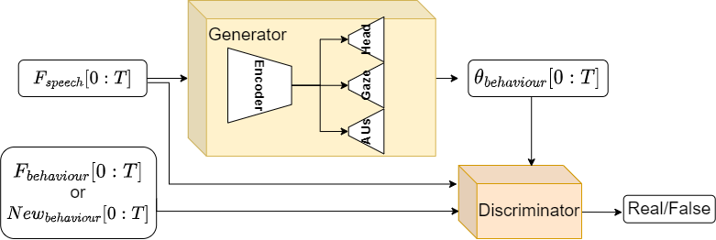
Model : Generative Adversarial Encoder-Decoder
JTT TALEP 2023
JTT TALEP 2023

Slide 14
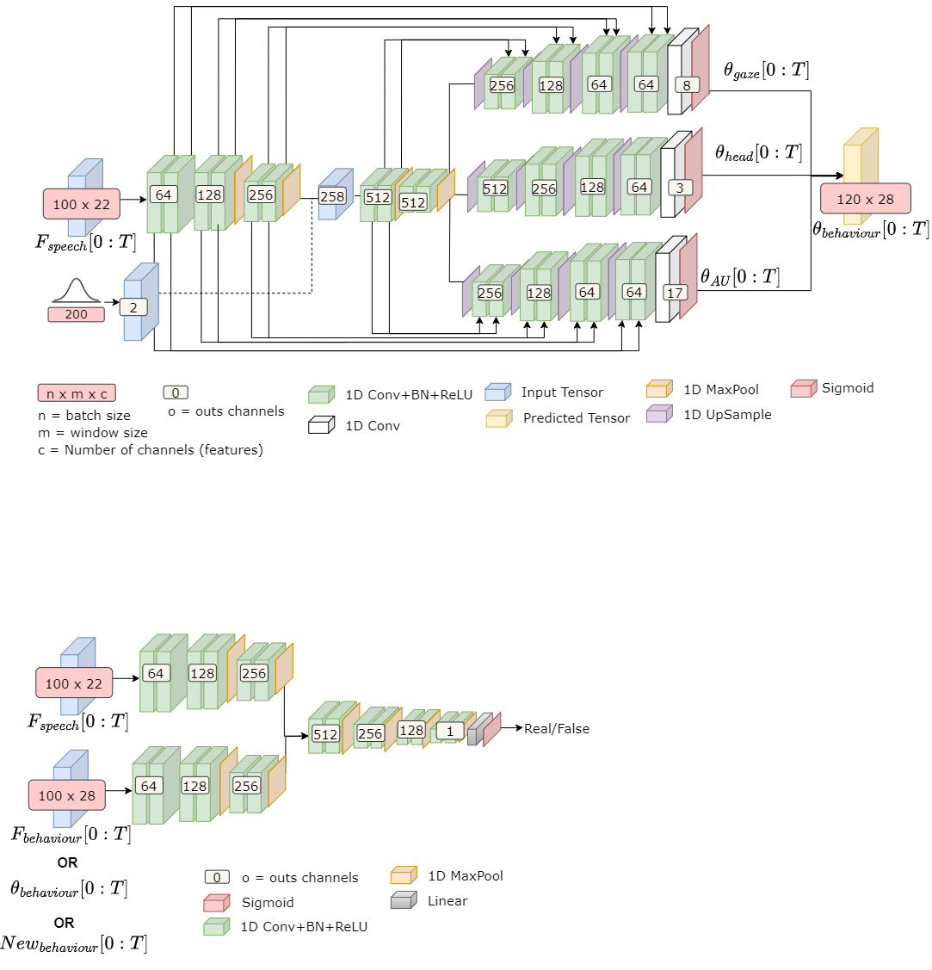
Generator architecture
JTT TALEP 2023
JTT TALEP 2023

Slide 15
Discriminator architecture
JTT TALEP 2023
JTT TALEP 2023

Slide 16
Research questions and hypotheses
Which factors influence the model to obtain :
o more or less human-like behaviours
o more or less speech-matched behaviors?
H1 : The perception of speech/behavior synchronization will be improved with the addition of our fake examples during training
H2 : With the addition of "less expressive" data during training, agents would move less, improving the perception of believability
H3 : with the addition of “noisier” data during training, agents will appear less synchronized
JTT TALEP 2023
JTT TALEP 2023

Slide 17
Generation example
JTT TALEP 2023
JTT TALEP 2023

Slide 18
Evaluation of generated non-verbal behaviour
JTT TALEP 2023
JTT TALEP 2023

Slide 19
The evaluation challenge
Objective evaluation
Measure the similarity between two signals (ground truth and generated signal)
graphical visualization of generated behaviors (curves or PCAs)
measurements of acceleration and jerk
→ Objective measures cannot assess all the complexity of social communication
Pre-selection
of models
Subjective evaluation
First user perceptive studies
How human-like does the behaviours appear?
how well does the agent's behavior match the speech? (in terms of rhythm and intonation)
Time-consumming
JTT TALEP 2023
JTT TALEP 2023

Slide 20
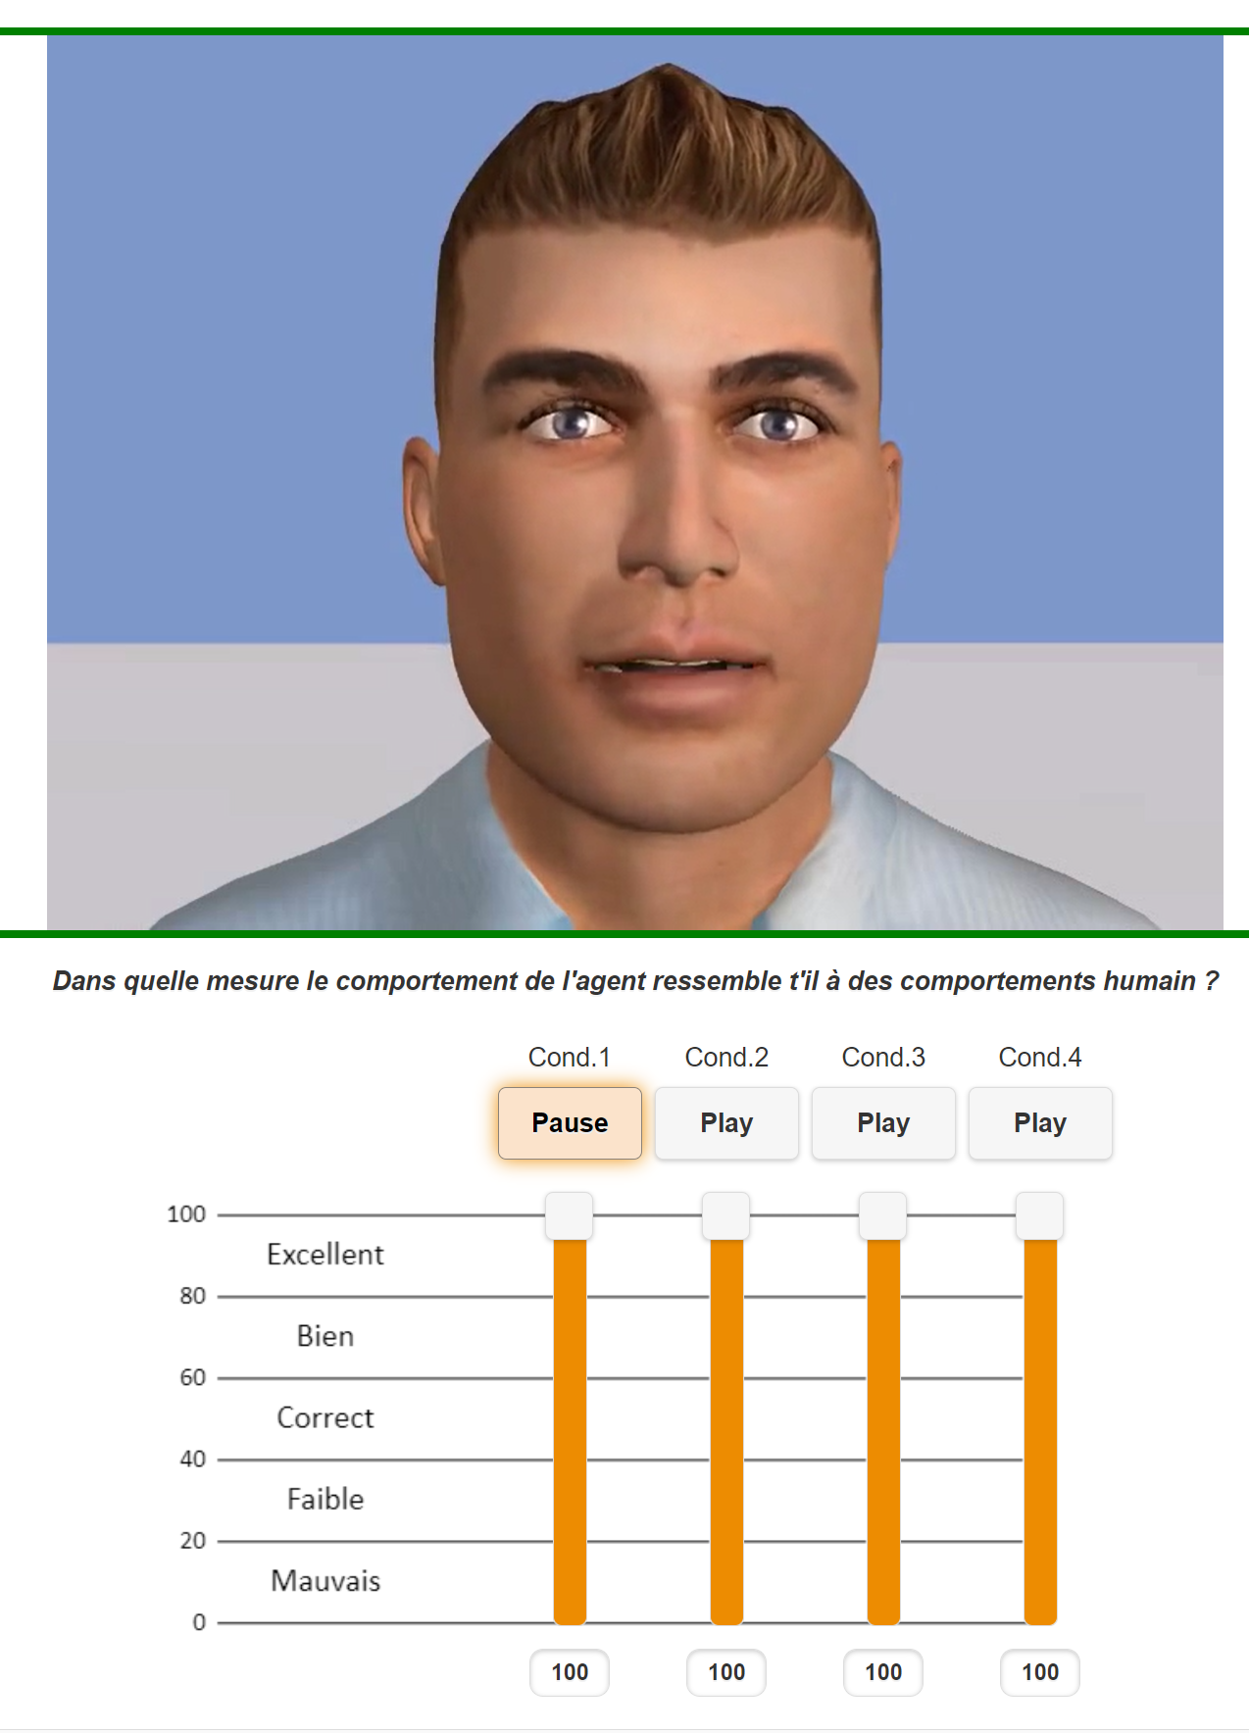
Some results if you took my experiment
H1 : The perception of speech/behavior synchronization will be improved with the addition of our fake examples during training
hypothesis significantly verified
H2 : With the addition of "less expressive" data during training, agents would move less, improving the perception of believability
→ hypothesis significantly verified
H3 : with the addition of “noisier” data during training, agents will appear less synchronized
→ trend but not significantly verified
ACAI 2023
ACAI 2023

Slide 21
And without comments to avoid distorting your evaluations :
JTT TALEP 2023
JTT TALEP 2023

Slide 22
Conclusion
Model to jointly generate the head movements, the gaze direction and the facial action units
some very important challenges remain:
better data sets
improved subjective and objective measurements
Generate higher-quality movements
production of more meaningful gestures
gesture stochasticity
multi-person interaction
spatial context of conversation
...
JTT TALEP 2023
JTT TALEP 2023

Slide 23
Thank you for listening !
If you want to take part in the project
https://pageperso.lis-lab.fr/alice.delbosc/video_evaluation_fr/
JTT TALEP 2023
JTT TALEP 2023

