Slide 1
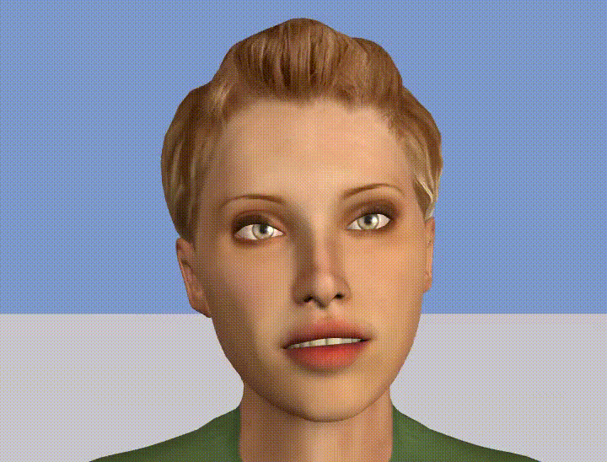
Conflict management training through simulation with conversational agent
Progress and perspectives
Alice Delbosc
PHD student
DAVI, The Humanizers
Stéphane Ayache
Professor LIS
Aix-Marseille University
Magalie Ochs
Associate professor LIS
Aix-Marseille University
Brian Ravenet
Associate Professor LISN
Paris-Saclay University
Nicolas Sabouret
Professor LISN
Paris-Saclay University
1

Slide 2
What are we going to talk about?
PROGRESS
Virtual agents
  Use case (conflict at work), limits, advantages, importance of non-verbal behaviour
Automatic generation of non-verbal behavior
Data, models and evaluation
PERSPECTIVES AND DISCUSSIONS
2

Slide 3
Use case: Interpersonal conflicts at work
Society becomes increasingly diverse and complex
→ more and more differences in point of view and objectives can lead to potential conflicts
Conflicts at work : quite common, causing stress and health problems
Beginning to be accepted that conflicts can bring positive results
→ improved autonomy, social cognitive skills, negotiating capacity
Proper management of workplace conflicts contribute to :
→ healthier and more peaceful work environment
→ increase of productivity
3

Slide 4
Training with virtual agent
Training by practice is a good form of learning
Still many obstacles to their use:
high production costs
resistance to change
lack of believability
…
Many important dimensions:
natural language generation and understanding
non-verbal behavior generation and understanding
Very few virtual agents deployed in the field of conflict management training
Existing ones controlled using Wizard-of-Oz
focus on the agent's non-verbal behavior
4

Slide 5
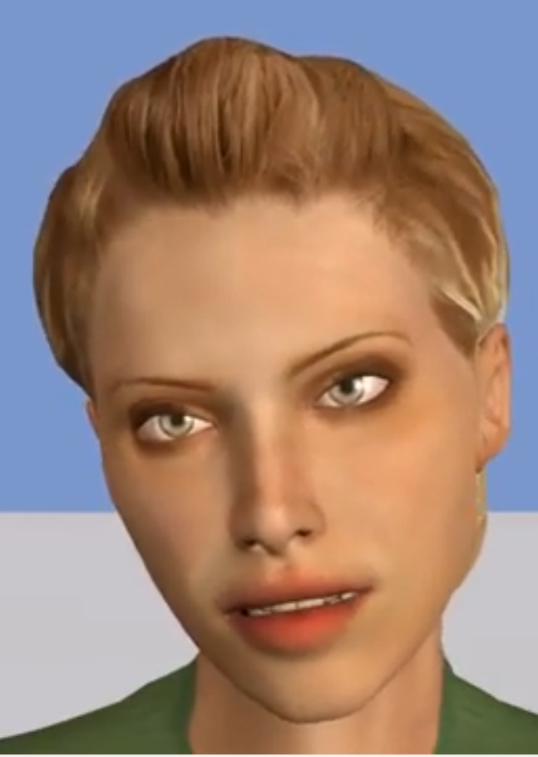
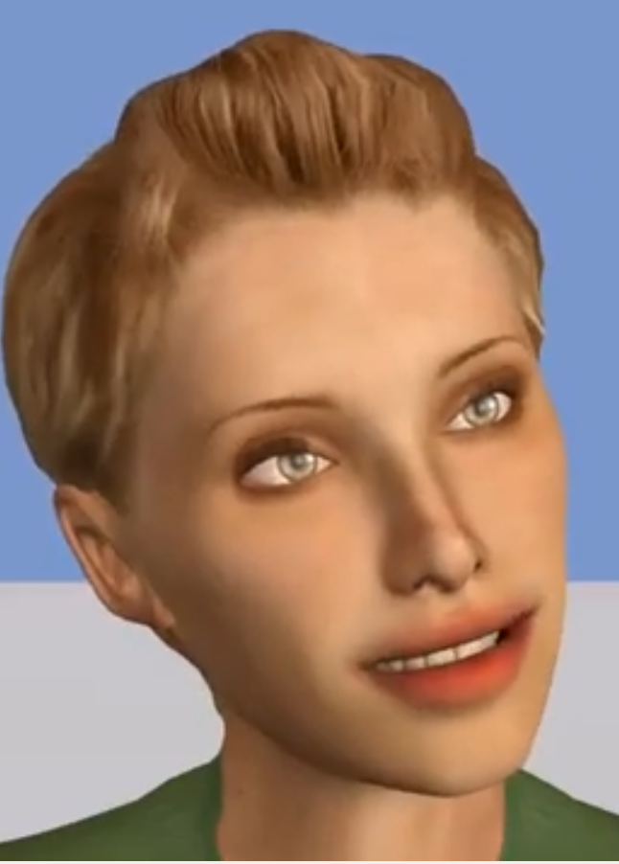
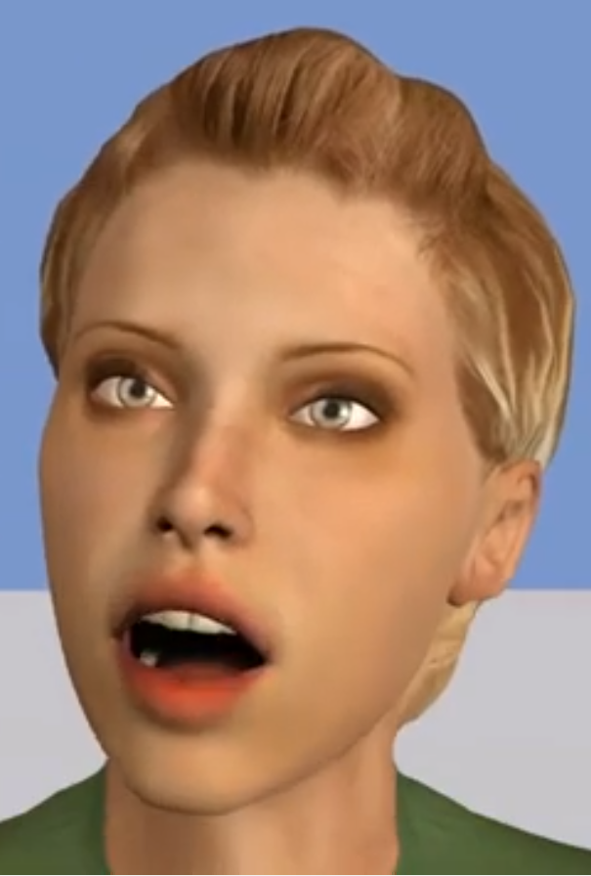
Why focus on non-verbal behavior?
For :
Socio-emotional information
Perception of the virtual agent in general
Speech intelligibility
Information retention
5

Slide 6
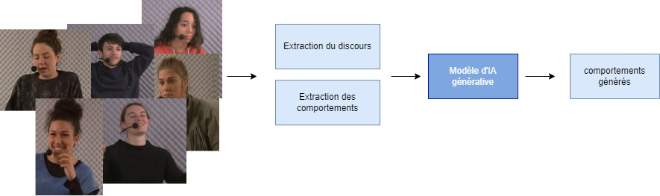
Automatic generation of non-verbal behavior
Datasets
Training
Inference and visualization
Features extraction
Model creation
Evaluation
6

Slide 7
Challenges in behavior generation
Data collection
Difficult to collect, low quality…
Multimodality
temporal and spatial information, semantic content, interlocutor behavior...
Idiosyncrasy of gestures
Redundancy of behavior and speech
Temporal synchronization
High subjectivity
7

Slide 8
The 4 Steps of my thesis
  Generate rhythmically relevant nonverbal behaviors for the virtual agent as he speaks
  Generate semantically and contextually relevant non-verbal behaviors for the virtual agent
  Incorporate a socio-affective dimension
  Take into account the user's multimodal signals and adjusting the simulation accordingly
1
2
3
4
8

Slide 9


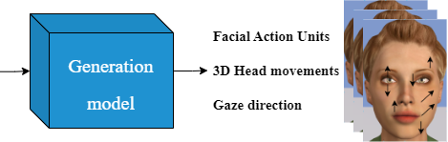
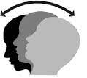

The 4 Steps of my thesis
  Generate rhythmically relevant nonverbal behaviors for the virtual agent as he speaks
1
Text input
Audio input
Non-linguistic modalities
Control Input
9

Slide 10
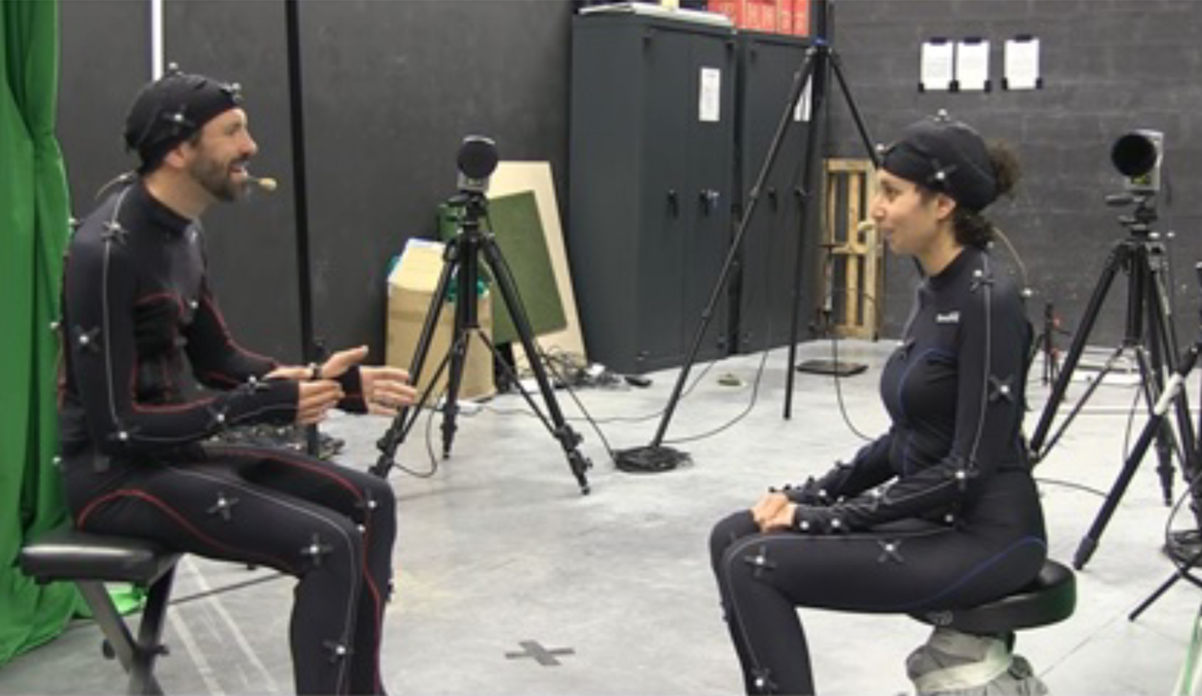
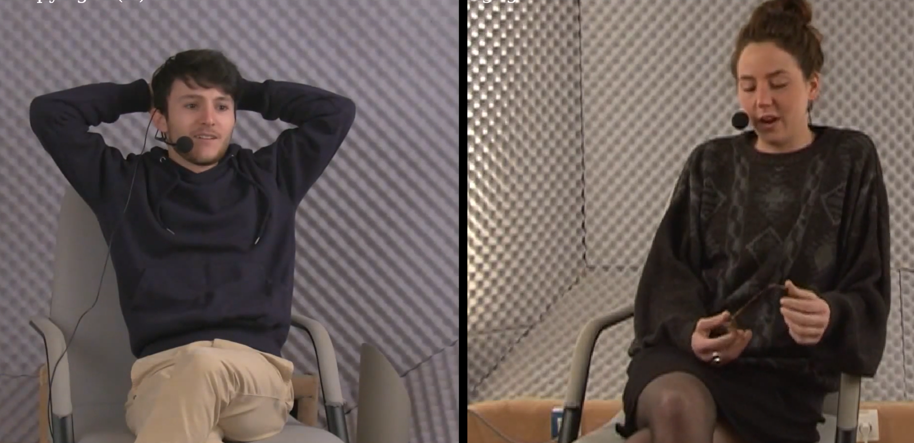
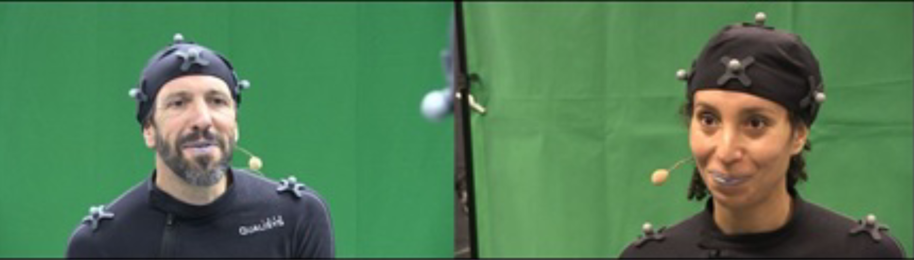
Selected datasets
“Less expressive”
“Farther-away shooting conditions”
Cheese
(20 videos, 20 people, ~5h)
“Main”
Trueness
(36 videos, 6 people,~3h30)
H2: The addition of “less expressive” data → improve the perception of believability
H3: The addition of “farther-away shooting conditions” data → degrade the perception of synchronization
10

Slide 11
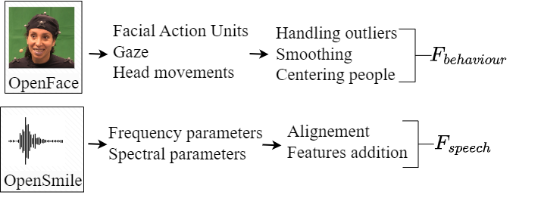
Extraction and processing of data
Addition of a binary features that indicates whether the person is speaking or not in audio features
Setting listening behaviors to 0, since we're only aiming to generate speaking behaviors at first
11

Slide 12
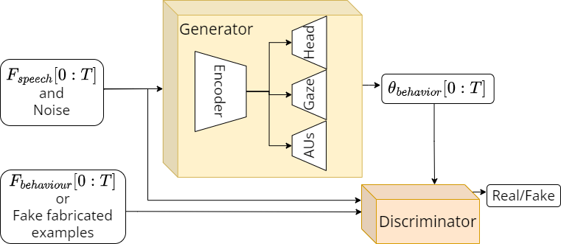
architecture : adversarial encoder-decoder
H1: The addition of our fake examples during training → improve the perception of speech/behavior synchronization
12

Slide 13
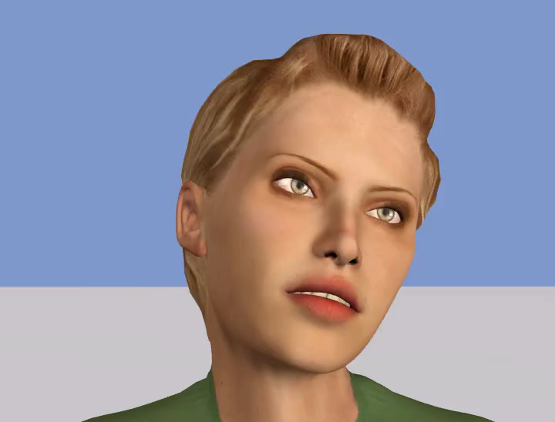
example
13

Slide 14
evaluation of generated behaviours
Objective:
Distance between the ground truth and generated distributions
Graphical visualization of generated behaviors (curves or ACP)
Average acceleration and jerk
Subjective (30 participants):
Believability: how human-like do the behaviors appear?
Temporal coordination: how well does the agent’s behavior match the speech?
14

Slide 15
Hypotheses and results
H1: The perception of speech/behavior synchronization will be improved with the addition of our fake examples during training
→ Significantly validated
H2: The addition of “less expressive” data during training, will improve the perception of believability
→ Significantly validated
H3: The addition of “farther-away shooting conditions” data during training will degrade the perception of synchronization
→ Significantly validated
15

Slide 16
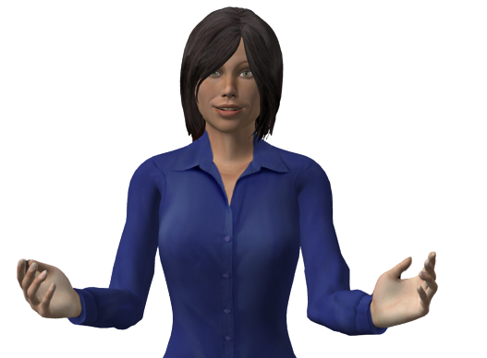
Conclusion (of the progress)
A new approach for the generation of rhythmically relevant non-verbal behavior
during the speech of a virtual agent
facial behavior generation based on action units
comparison between using a small amount of suitable data VS a larger amount of data
evaluation of the effects of adding new relevant fake fabricated examples during the training phase of an adversarial model
There are still many challenges to overcome!
do you have any questions
about the current work?

Slide 17
AND NOW ?
PERSPECTIVES AND DISCUSSIONS
Improve my input data
Towards the integration of semantics and context
    Replacing OpenSmile features with Hubert
    Addition of the dialogue acts during training
    Addition of text features FlauBERT during training
The continuity of generated behaviors
Time saving and architecture
17

Slide 18
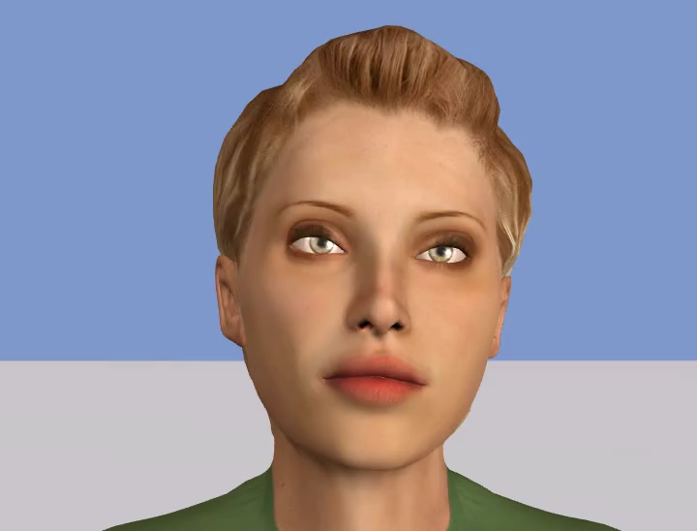
Improve my input data
18

Slide 19
AND NOW ?
PERSPECTIVES AND DISCUSSIONS
Improve my input data
Towards the integration of semantics and context
    Replacing OpenSmile features with Hubert
    Addition of the dialogue acts during training
    Addition of text features FlauBERT during training
The continuity of generated behaviors
Time saving and architecture
19

Slide 20
Replacing OpenSmile features with Hubert
Today : extraction of speech features with the toolbox OpenSmile
(pitch (F0), cepstral coefficients (MFCC),…)
Goal: use the HuBERT model to incorporate and encode both lexical and non-lexical information
Questions:
Is it enough to use the pre-trained model or do I have to finetune it?
Is it better to use the original model or a finetuned version in French?
20

Slide 21
Addition of dialogue acts
classifying an utterance with respect to the function it serves in a dialogue, i.e. the act the speaker is performing → high-level information on speech semantics and context
1st solution: DialogTag
created for telephone conversations→ not necessarily the perfect tags for our context
made for English
made for sentences, not IPUs
2d solution: API GPT
Prompt improvement?
Give examples before learning?
Performances evaluation?
21

Slide 22
Text features: FlauBERT
Addition of semantic features with BERT-type model
Questions:
In association with OpenSmile or Hubert?
Is finetuning necessary?
How to keep learning in 4s sequence and integrate the flauBERT embeddings?
22

Slide 23
AND NOW ?
PERSPECTIVES AND DISCUSSIONS
Improve my input data
Towards the integration of semantics and context
    Replacing OpenSmile features with Hubert
    Addition of the dialogue acts during training
    Addition of text features FlauBERT during training
The continuity of generated behaviors
Time saving and architecture
23

Slide 24
The continuity of generated behaviours
Today : Average with overlap on a few frames
Goal: Integrate previous frames into the learning process so that the model generates continuity in behavior
Questions:
how many frames to give the model?
do I give it several frames or an initial position and then high-level features (direction, speed, ...)?
24

Slide 25
AND NOW ?
PERSPECTIVES AND DISCUSSIONS
Improve my input data
Towards the integration of semantics and context
    Replacing OpenSmile features with Hubert
    Addition of the dialogue acts during training
    Addition of text features FlauBERT during training
The continuity of generated behaviors
Time saving and architecture
25

Slide 26
Time savings and architecture
Today : Jean-zay, pytorch lightning, 1 gpu
Goal: multi gpu
Problems:
Obtain the same model, for example I couldn’t implement sync_batchnorm
no time saving
26

Slide 27
Annexes
27

Slide 28



Selected features
Audio features | Behaviour features
alphaRatio hammarbergIndex Mfcc1 Mfcc2 Mfcc3 F0semitoneFrom27.5Hz logRelF0-H1-H2 | gaze_0_x, gaze_0_y, gaze_0_z gaze_1_x, gaze_1_y, gaze_1_z gaze_angle_x, gaze_angle_y pose_Rx, pose_Ry, pose_Rz AU01, AU02, AU04, AU05 AU06, AU07, AU09, AU10, AU12 AU14, AU15, AU17, AU20, AU23 AU25, AU26, AU45
28

Slide 29
Fake examples creation
Batch percentage | Details
1/3 | generated by the generator
1/3 | "listening" audio features associated with "speaking" behavior features
1/3 | "speaking" audio features associated with "listening" behavior features
29

Slide 30
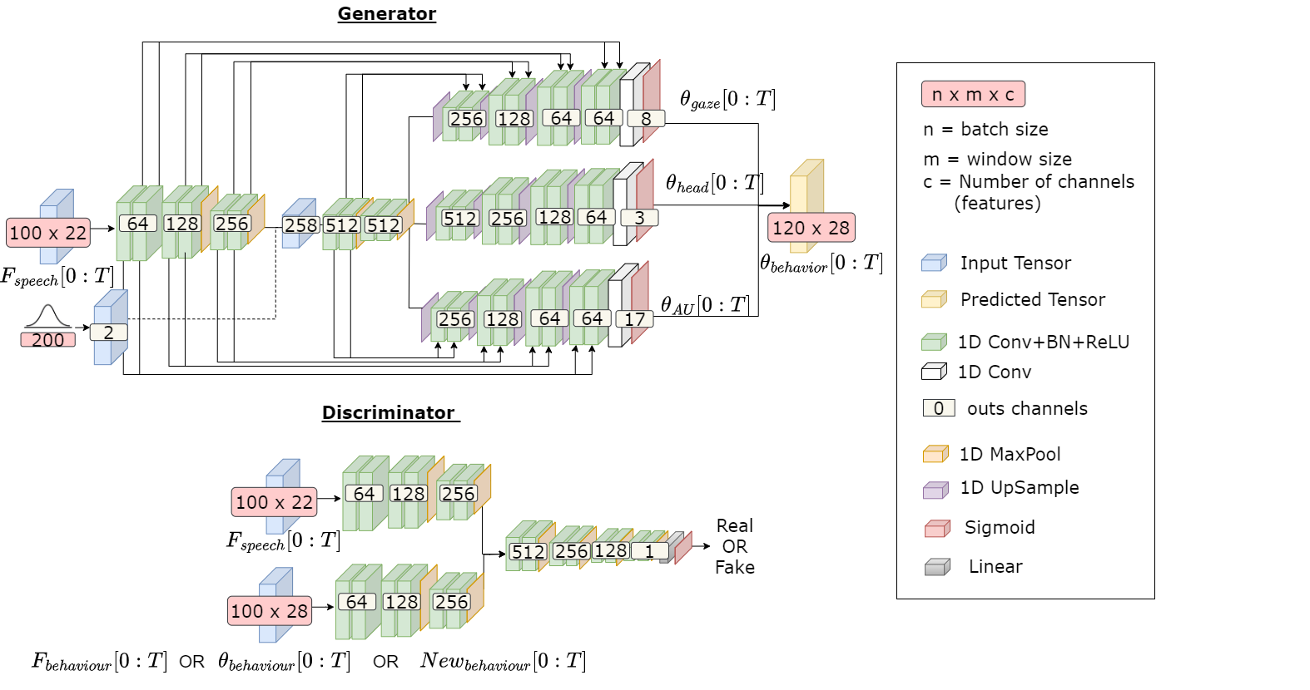
Detailed architecture
30

Slide 31
Results (H1): The addition of fake fabricated examples
Objective evaluation
Subjective evaluation
 | with fake examples | w/o fake examples
DTW | 451.23 | 460.90
 | with fake examples | w/o fake examples
Coordination | 43.42 | 38.77
Believability | 45.39 | 39.02
Reduce the distance between
the generated distribution and the GTS distribution
Enhance the perception of synchronization and believability
 | with fake examples | w/o fake examples
Acceleration | 13.49 | 19.02
Jerk | 545.66 | 768.00
Generate smoother movements
Our fake examples increase performances
31

Slide 32
Results (H2-3): The addition of cheese dataset
Objective evaluation
Subjective evaluation
 | w/o Cheese | With Cheese
DTW | 451.23 | 484.57
 | w/o Cheese | With Cheese
Coordination | 43.42 | 38.82
Believability | 45.39 | 58.74
Increase the distance between
the distributions of generated data and GTS data
Increase the perception of believability
Reduce the perception of synchronization
 | w/o Cheese | With Cheese
Acceleration | 13.49 | 9.10
Jerk | 545.66 | 358.62
Adding data does not necessarily increase performances
Generate smoother movements
32

