Slide 1
Knowledge Graph Embedding
By Sebastien Montella
Link Prediction

Slide 2
Outline
Definition & Basics
Problem Setting
Approaches & Methods
Experiment & Evaluation

Slide 3
FUndamentals

Slide 4
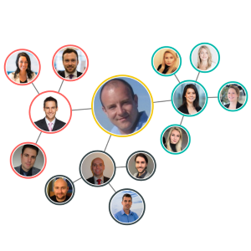
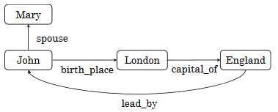
Graph - Formalization
Undirected
+
Homogeneous
$G=(V, E)$
$V$: Vertices
$E$: Edges
Examples:
Directed
+
Heterogeneous

Slide 5
Resource Description Framework
Motivations
Extract Knowledge from the Web Resources
Structured Representation
Formal Definition
RDFs are Triples : < $s_{i}$, $p_{i}$, $o_{i}$>
$s_{i}$: The subject
$p_{i}$: The predicate (i.e. relations)
$o_{i}$: The object
Triplet may be written as <h, r, t>:
Head (h) = $s$
Relation (r) = $p$
Tail (t) = $o$

Slide 6
Resource Description Framework
Example
John
birth place
<John, birth place, Paris>
Paris
<John , spouse, Ava>
spouse
<Ava, lives in, Paris>
lives in
Ava
Oriented
Graph
RDF Triples
From Graph to Sentences . . .

Slide 7
Problem setting

Slide 8
Problem Setting - Motivation
The increase of Knowledge Bases (KBs) in RDF format enables the use of machine learning methods
Cost of Graph Analytics
Computation-wise
Space-wise
Bench of applications (question answering, profile summarization, reasoning, etc.)
Notes:
Why related to your thesis

Slide 9
Problem Setting - Goal
Learn (useful) representations of the Knowledge Graph:
Entity-level ?
Relation-level ?
Triple –level ?
Subgraph level ?
Whole Graph level ?

Slide 10
Problem Setting - Goal
Level of Embeddings depends on the task (and of the data . . .)
For protein classification, embedding a single atom may be useless.
In dialog, classifying turns may leverage subgraph embeddings as features.
To provide in-depth NLU systems, a finer-grained approach would be appreciated, even combined level.

Slide 11
Problem Setting - Goal
Project entities and relations in a continuous vector space $S$ s.t. $dim\left(S\right)≪ \left|V\right|$
Vector representations of entities should keep their (dis)similarity based on their corresponding relation (or not).
Overall structure of the graph should be kept could be found back from S.

Slide 12
Approaches & Methods

Slide 13
Approaches - Taxonomies
Different paradigms exist to embed entities and relations :
Proximity
Entities close to each other should be close in the vector space
Edge Reconstruction
Maximize the probability/ rank of entities linked to each other via a relation r, while minimizing it for unrelated entities.
Other
Notes:
Not complete → hard to define a complete and exact taxonomies among all techniques !

Slide 14
Approaches – Link Prediction
KBs are in most cases incomplete ☹
Lack of data
Missing information
No deductive reasoning
Leverages of KBs completion by link prediction
Adding new information
Learning entities and relations embeddings ☺
Notes:
Not complete → hard to define a complete and exact taxonomies among all techniques !

Slide 15
Methods - Timeline
(Some) Models on Link Prediction Task . . .
NTN
NIPS
2013
TransH
AAAI
2014
DistMult
ICLR
2015
HolE
AAAI
2016
TorusE
AAAI
2018
KBGAN
NAACL
2018
TuckER
arxiv
2019
QuatE
NIPS
2019
RESCAL
ICML 2011
TransE
NIPS
2013
TransR
AAAI
2015
ComplEx
ICML
2016
DKRL
AAAI 2016
ConvE
AAAI
2018
RotatE
ICLR 2019
MuRP
NIPS
2019

Slide 16
What is a good model ?
Should have the capacity to model different type of relations between entities
Relation Type | Formalism | Example
Symmetric | (h, r, t) implies (t, r, h) | (A, is_married, B) and (B, is_married, A)
Anti-Symmetric | (h, r, t) implies (t, r, h) to be wrong | (A, is_father, B) and (B, is_father, A)
Inversion | (h, r1, t) implies (t, r2, h) | (A, is_father, B) and (B, is_child, A)
Composition | (h1, r1, t2) and (t2, r2, t3) Implies (h1, r3, t3) | (A, is_father, B) And (B, is_father, C) Implies (A, is_grandfather, C)

Slide 18
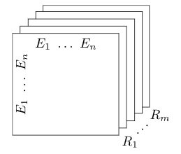
Tensor Factorization
$X$: Tensor of Size $n ×n ×m$
$n=\# entities$and $m=\# relations$
$X_{ijk}=1$ ↔ The $i^{th}$ entity and $j^{th}$entity are connected with the $k^{th}$relation.
Each slice $X_{k}$is factorized as $AR_{k}A^{T}$
$A ∈ℝ^{n×m}$: Latent representations of entities
$R_{k}∈ℝ^{m×m}$: Asymmetric matrix modeling the $k^{th}$relation
Loss function
$\min_{A,R_{k}}{{\frac{1}{2}\left\|X_{k}−AR_{k}A^{T}\right\|}_{F}^{2}}+ \frac{1}{2}λg{\left(A,R_{k}\right)}^{2}$
RESCAL
ICML 2011
Regularizer

Slide 19
#TODO
NTN
NIPS
2013

Slide 20
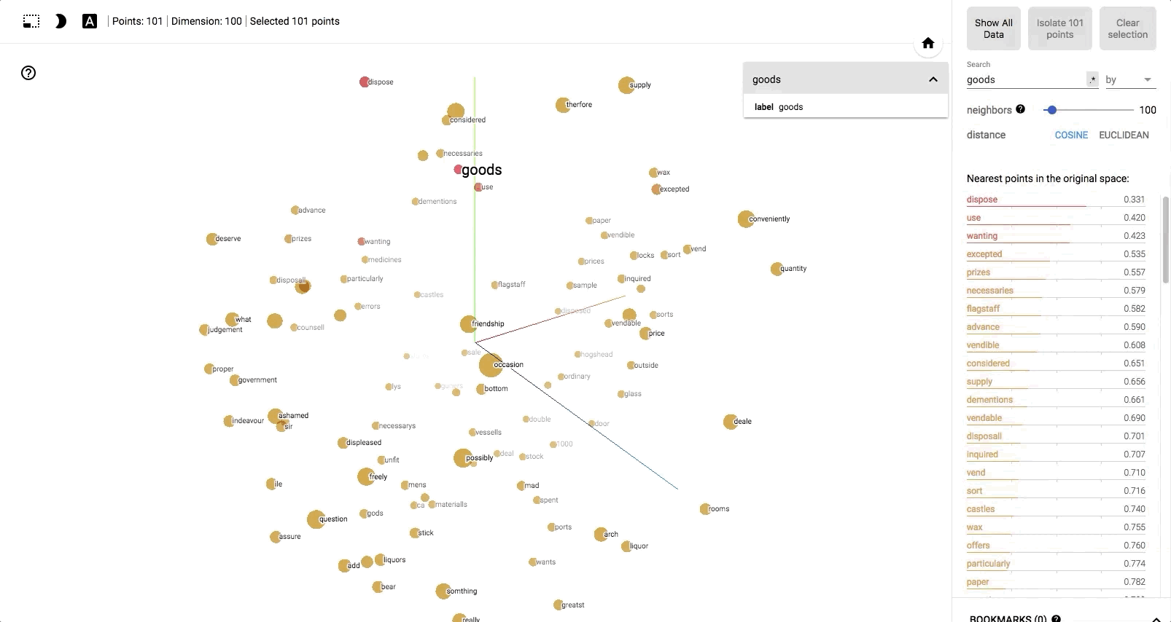
Remember Word Embedding ?
TransE
NIPS
2013

Slide 21
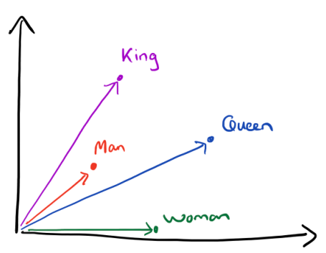
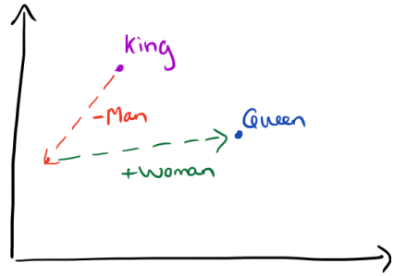
Remember Word Analogy ?
Woman is to Queen as Man is to King
TransE
NIPS
2013

Slide 22
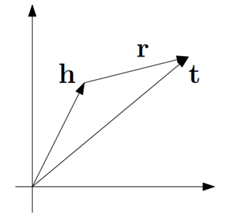
“Translation in the Embedding space”
$h, r, t ∈ℝ^{k}$ where $k$ is an arbitrary parameter
All projected in the same vector space
If $(h, r, t)$ is True ➔$h+r≈t$
$d\left(h+r, t\right)≈0$ with $d\left( .\right)$the squared Euclidean distance
If $(h, r, t)$ is not True ➔$h+r≉t$
$d\left(h+r, t\right)≫0$
Scoring function
TransE
NIPS
2013
Notes:
Distance function acting as the scoring function. Solely requirements for pple to create a new model is to define another scoring function, and there you go !

Slide 23
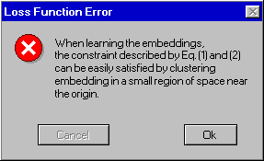
“Translation in the Embedding space”
Loss Function
Main idea:
$\min\left(d\left(h+r, t\right)\right)$ for $\left(h, r, t\right)∈S$, with $S$ the set of correct triplets.
$max⁡(d\left(h^{′}+r, t′\right))$ for $\left(h′, r, t′\right)∈S^{′}$, with $S′$ the set of corrupted triplets
Corrupted triplets are built by removing head or tail of a correct triple from , and randomly selecting another entity.
In other words we want:
$d\left(h^{ }+r, t\right) ≤ d\left(h^{′}+r, t′\right)$ (1)
$d\left(h^{ }+r, t\right) − d\left(h^{′}+r, t^{′}\right) ≤0$ (2)
$d\left(h^{ }+r, t\right) − d\left(h^{′}+r, t^{′}\right) ≤− γ$ (3)
Final Loss Function
$ℒ= d\left(h^{ }+r, t\right) − d\left(h^{′}+r, t^{′}\right)+ γ$
TransE
NIPS
2013

Slide 24
“Translation in the Embedding space”
Optimization Tip:
$ℒ= d\left(h^{ }+r, t\right) − d\left(h^{′}+r, t^{′}\right)+ γ$
$$d\left(h+r, t\right)={\left\|h+r−t\right\|}_{2}^{2}$$
$$={\left\|h+r\right\|}_{2}^{2}−2t^{T}\left(h+r\right)+{\left\|t\right\|}_{2}^{2}$$
$$={\left\|h\right\|}_{2}^{2}+2h^{T}r+{\left\|r\right\|}_{2}^{2}−2t^{T}\left(h+r\right)+{\left\|t\right\|}_{2}^{2}$$
$$={\left\|h\right\|}_{2}^{2}+{\left\|r\right\|}_{2}^{2} {+ \left\|t\right\|}_{2}^{2}−2t^{T}(h^{T}t+r^{T}\left(t−h\right))$$
Increase
entities norms!
$$⇔𝓛={\left\|h\right\|}_{2}^{2}+{\left\|r\right\|}_{2}^{2} {+ \left\|t\right\|}_{2}^{2}−2t^{T}\left(h^{T}t+r^{T}\left(t−h\right)\right)−{\left\|h^{′}\right\|}_{2}^{2}$$
$$−{\left\|r\right\|}_{2}^{2} {− \left\|t^{′}\right\|}_{2}^{2}+2{t^{′}}^{T}\left({h^{′}}^{T}t^{′}+r^{T}\left(t^{′}−h^{′}\right)\right)+γ$$
$$={\left\|h\right\|}_{2}^{2} {+ \left\|t\right\|}_{2}^{2}−{\left\|h^{′}\right\|}_{2}^{2} {− \left\|t^{′}\right\|}_{2}^{2}−2t^{T}\left(h^{T}t+r^{T}\left(t−h\right)\right)$$
TransE
NIPS
2013
$$+ 2{t^{′}}^{T}\left({h^{′}}^{T}t^{′}+r^{T}\left(t^{′}−h^{′}\right)\right)+γ$$
Additional constraint: ${\left\|h\right\|}_{2}^{2}={\left\|t\right\|}_{2}^{2}=1$

Slide 25
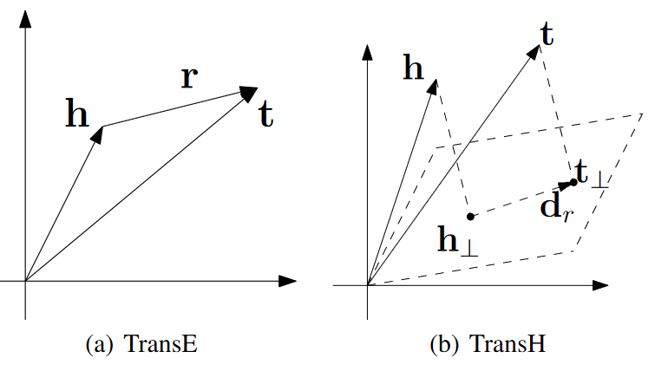
From TransE to TransH
$$w_{R}$$
$$w_{R}$$
TransH
AAAI
2014
Zhen Wang, Jianwen Zhang, Jianlin Feng, Zheng Chen, Knowledge Graph Embedding by Translating on Hyperplanes, AAAI 2014.

Slide 26
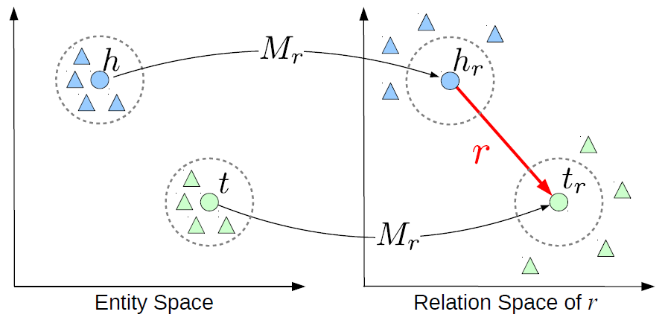
From TransE to TransR
Distinct spaces
Entity space: $h, t∈ℝ^{k}$
Relation space: $r∈ℝ^{d}$
$h_{r}= M_{r}^{T}h$ and $t_{r}=M_{r}^{T}t$ with $M_{r}^{}∈ℝ^{k×d}$
Loss function
$ℒ= d\left({h_{r}}^{ }+r,t_{r}\right) − d\left(h_{r}^{′}+r, t_{r}^{′}\right)+ γ$
TransR
AAAI
2015

Slide 27
DistMult tries to generalize NTN and TransE models
Entity-wise
$h=f(Wx_{h})$ and $t=f(Wx_{t})$
$x_{h}$and $x_{t}$ are one-hot vectors for entity $h$and $t$ respectively
$W$is a parameter matrix (can be pre-trained)
$f$ can be a linear or non-linear function
tanh is used in paper
Relation-wise
$g_{r}^{b}\left(h, r, t\right)=h^{T}{diag(M}_{r})t$
$M_{r}$: learnable parameter
Loss function
$ℒ=g_{r}^{b}\left(h, r, t\right)−g_{r}^{b}\left(h^{′}, r, t^{′}\right)+ γ$
DistMult
ICLR
2015

Slide 28
From $ℝ$to ℂ
ComplEx wants to better model anti-symmetric relations.
DistMult handles perfectly symmetric relations but can’t model anti-symmetric ones
$P\left(Y_{rso}=1\right)= σ(X_{rso})$
$X_{rso}$: Latent matrix of score for triplet (s, r, o)
$Y_{rso}$: 1 if (s, r, o) holds, -1 otherwise
Scoring function
${X_{rso}=φ(r, s, o)=Re\left(<w_{r}, e_{s}, \overline{e_{o}}>\right)}_{ }$
$w_{r}∈{\text{ℂ}}^{K}$, $e_{s}∈{\text{ℂ}}^{K}$, $e_{o}∈ {\text{ℂ}}^{K}$
Loss Function
$ℒ=log⁡(1+exp⁡(−Y_{rso}$ $φ(r, s, o)))+ λ{\left\|Θ\right\|}_{2}^{2}$
ComplEx
ICML 2016
Regularizer

Slide 29
HolE
AAAI 2016

Slide 30
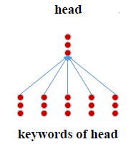
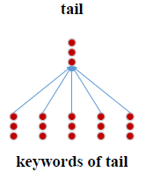
DKRL = TransE + Entities Description
Assumption: Similar entities should have similar description/keywords
Two Level of Representations
Structure-based: $h_{s}, t_{s}$
Description-based: $h_{d}, t_{d}$
Keywords are used
CBOW + CNN as description embedding
Scoring function
$E_{s}={\left\|h_{s}+r−t_{s}\right\|}_{2}^{2}$
$E_{D}=E_{DD}+E_{DS}+E_{SD}$
$E_{DD}={\left\|h_{d}+r−t_{d}\right\|}_{2}^{2}$
$E_{DS}={\left\|h_{d}+r−t_{s}\right\|}_{2}^{2}$
$E_{SD}={\left\|h_{s}+r−t_{d}\right\|}_{2}^{2}$
Loss function
$ℒ= d\left(h^{ }+r, t\right) − d\left(h^{′}+r, t^{′}\right)+ γ$
DKRL
AAAI
2016

Slide 31
What is a Torus?
Hint:
TorusE
AAAI
2018

Slide 32
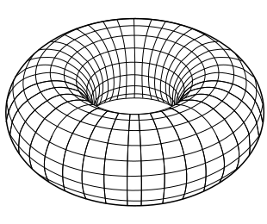
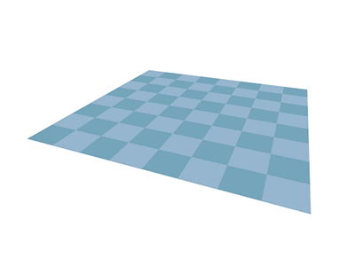
What is a Torus?
TorusE
AAAI
2018

Slide 33
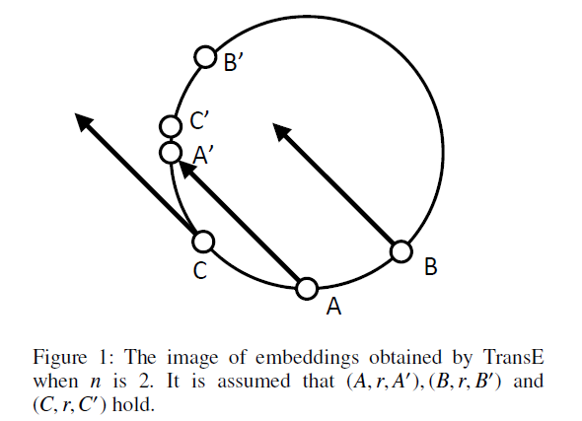
TorusE wants to solve a major issue of TransE
TransE requires that entities norm are normalized: ${\left\|h\right\|}_{2}^{2}={\left\|t\right\|}_{2}^{2}=1$
Raising Issue
TorusE
AAAI
2018

Slide 34
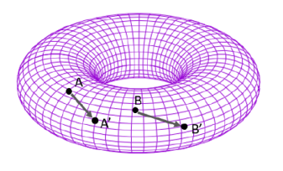
TransE vs TorusE
 | TransE | TorusE
Embedding Space | $$h, r, t ∈ℝ^{n}$$ | $${\left[h\right], \left[r\right], \left[t\right] ∈T}^{n}$$
Bounded | No | Yes
Translation-based | Yes $$h+r=t$$ | Yes $${\left[h\right]+\left[r\right]= \left[t\right] }^{ }$$
Distance function | $${\left\|h+r −t\right\|}_{i}^{}$$ | $$\min_{\left(x, y\right)∈\left(\left[h\right]+\left[r\right]\right)×[t]}{{\left\|x−y\right\|}_{i}^{}}$$
Loss Function | Margin-based | Margin-based
TorusE
AAAI
2018

Slide 35
ConvE
AAAI
2018

Slide 36
KBGAN
NAACL2018

Slide 37
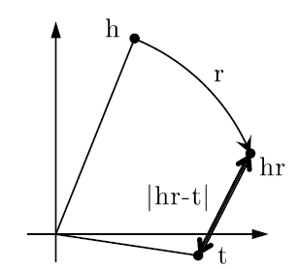
RotatE = Relations as Rotations !
Relations are seen as a (complex) rotation from head entity $h$ to tail entity $t$.
$h, r, t∈{\text{ℂ}}^{k}$
$t=h○r$ ($○$ = Hadamard product)
$\left|r_{i}\right|=1 ⇔r_{i}=e^{iθ_{r_{i}}}⇒$counterclockise rotation by $θ_{r_{i}}$ rad.
Scoring function
$d\left({h_{ }}^{ }○ r,t_{ }\right)={\left\|{h_{ }}^{ }○ r −t\right\|}_{1}^{}$
Loss function
RotatE
ICLR
2019

Slide 38
TuckER
Arxiv
2019

Slide 39
MuRP
NIPS
2019
Hyperbolic space
Suitable for modelling hierarchical data

Slide 40
QuatE
NIPS
2019
Rotations from ℂ to ℍ
ℍ for Hyper-complex (or Hamilton)
Hamilton defines Quaternions in 1843 as:
$a+bi+cj+dk$with $a,b,c,d ∈ℝ$ and $i^{2}=j^{2}=k^{2}=ijk=−1$
Composed of 3 imaginary parts
Why quaternions?
Memory Storage
Efficient
Gimbal Lock
Loss of one degree of freedom when usig Euler’s angles

Slide 41
QuatE
NIPS
2019
Quaternion Embeddings
$Q∈{\text{ℍ}}^{n×k}$: Entities Embeddings (dim= $k$)
$W∈{\text{ℍ}}^{m×k}$: Relations Embeddings (dim= $k$)
For a triplet $(h,r, t)$
$h ↦Q_{h}=a_{h}+b_{h}i+c_{h}j+d_{h}k$ with $a_{h}$, $b_{h}$, $c_{h}$, $d_{h} ∈ ℝ^{k}$
$r ↦W_{r}=a_{r}+b_{r}i+c_{r}j+d_{r}k$ with $a_{r}$, $b_{r}$, $c_{r}$, $d_{r} ∈ ℝ^{k}$
$t ↦Q_{t}=a_{t}+b_{t}i+c_{t}j+d_{t}k$ with $a_{t}$, $b_{t}$, $c_{t}$, $d_{t} ∈ ℝ^{k}$

Slide 42
QuatE
NIPS
2019
Quaternion Embeddings
As for RotatE, the head entity $Q_{h}$ is rotated with the relation $W_{r}$
$Q_{h}^{′}=Q_{h}⊗ W_{r}^{⊲}$ with $Q_{h}^{′}$ the resulting rotation, $W_{r}^{⊲}$ the normalization of $W_{r}$ and$⊗$ the Hamilton product (refer to the paper for details)
Scoring function
$φ\left(h, r, t\right)= Q_{h}^{′} . Q_{t}=\left\langle a_{h}^{′},a_{t}\right\rangle +\left\langle b_{h}^{′},b_{t}\right\rangle +\left\langle c_{h}^{′},c_{t}\right\rangle +\left\langle d_{h}^{′},d_{t}\right\rangle$
Loss function
$ℒ=log⁡(1+exp⁡(−Y_{hrt}$ $φ(h, r, t)))+ λ{\left\|Θ\right\|}_{2}^{2}$
That was the last model … ☺

Slide 43
What about data ?
Where to find triples ?

Slide 44
Datasets
Models trained on the Link Prediction Task are mostly evaluated using:
Wordnet
Freebase

Slide 45
Datasets - WordNet
Lexical Database for English Language (Princeton university)
Words are linked by conceptual-semantic and lexical relations types
Ex:
meat _hypernym beef
yearly derivationally_related_form year
player _member_meronym team
Two subsets for Link Prediction
WN18 (18 relations)
WN18RR (inverse relation removed)

Slide 46
Datasets - Freebase
(Structured) General Human Knowledge
Stored as Triples (Entity-Relationship manner)
In 2014, 2.4 billion facts
Shut Down in 2016
Large Database
Two subsets for Link Prediction
FB15K (~15K entities, ~1400 relations)
FB15K-237 (237 relations, inversed relation removed

Slide 47
Datasets - Statistics
Dataset | N | M | Training | Validation | Test | Avg. Degree
WN18 | 40,943 | 18 | 141,442 | 5,000 | 5,000 | 3.45
WN18RR | 40,943 | 11 | 86,835 | 3,034 | 3,134 | 2.19
FB15K | 14,951 | 1,345 | 483,142 | 50,000 | 59,071 | 32.31
FB15K-237 | 14,541 | 237 | 272,115 | 17,535 | 20,466 | 18.71

Slide 48
EValuation
Experiment Protocol

Slide 49
Evaluation
Experiment protocol
For each test triplet $\left(h, r,t\right)$
Replace $h$ with each of the entities of the dictionary → $\left(h′, r,t\right)$
Compute the scoring function for those new triples
For TransE: $d\left(h′+r,t\right)$
Sort scores of those triples by ascending order
Save the rank of your ground truth head entity $h$
Repeat protocol by replacing $t$ with each of the entities of the dictionary → $\left(h, r,t′\right)$

Slide 50
Evaluation
Experiment protocol - Example
(Trump, president of, U.S.A.)
(?, president of, U.S.A)
TransE

Slide 51
Evaluation
Let’s rank entities I know based on my scoring function
Experiment protocol - Example
(Trump, president of, U.S.A.)
$$d_{TransE}\left(Obama+president of, U.S.A\right)=0.01$$
Entities | Scoring function
B. Obama | 0, 01
D. Trump | 0, 45
Tomato | 4, 5
Book | 5, 6
$$⋮$$ | $$⋮$$
(?, president of, U.S.A)
TransE

Slide 52
Evaluation
Let’s rank entities I know based on my scoring function
Experiment protocol - Example
Let’s check the rank of the correct answer (Trump) . . .
Entities | Scoring function
B. Obama | 0, 01
D. Trump | 0, 45
Tomato | 4, 5
Book | 5, 6
$$⋮$$ | $$⋮$$
(?, president of, U.S.A)
TransE
Rank = 2

Slide 53
Evaluation
What the **** are MR, MRR, Hit@1, Hit@3 and Hit@10 ??
Experiment protocol - Example
You ranked the correct answer 2nd !
Your MR is 2, MRR is 0.5, Hit@1 is 0, and both Hit@3 and Hit@10 are 1.
(?, president of, U.S.A)
TransE

Slide 54
Metrics
Mean Rank (MR)
Mean Reciprocal Rank (MRR)
Hit@N

Slide 55
Mean Rank (MR)
Number of testing triplet
$$MR= \frac{1}{N}\sum_{i}^{N}{rank_{i}}$$
Rank of the correct entity for the $i^{th}$ testing triplet.

Slide 56
Mean Reciprocal Rank (MRR)
Number of testing triplet
$$MRR= \frac{1}{N}\sum_{i}^{N}{\frac{1}{rank_{i}}}$$
Rank of the correct entity for the $i^{th}$ testing triplet.

Slide 57
Hit@N
Ratio of correct entities ranked in the top-n entities according to the model
Hit@1: Proportion of correct entities predicted as the top entity (rank = 1)
Hit@1=30% ➔ 30% of correct entities ranked 1st
Hit@3: Proportion of correct entities predicted in the top-3
Hit@3=55% ➔55% of correct entities ranked in the top-3
Hit@10: Proportion of correct entities predicted in the top-10
Hit@10=75% ➔75% of correct entities ranked in the top-10

Slide 58
(Some) Results – On WN18
WN18
Model | MR | MRR | Hit@10 | Hit@3 | Hit@1
RESCAL | 1163 | - | 0,528 | - | -
TransE | 251 | 0,397 | 0,923 | 0,745 | 0,04
TransR | - | 0,605 | 0,94 | 0,876 | 0,335
DistMult | 655 | 0,797 | 0,946 | - | -
ComplEx | - | 0,941 | 0,947 | 0,945 | 0,936
TorusE | - | 0,947 | 0,954 | 0,95 | 0,943
ConvE | 374 | 0,943 | 0,935 | 0,946 | 0,956
RotatE | 184 | 0,947 | 0,961 | 0,953 | 0,938
QuatE | 162 | 0,95 | 0,959 | 0,954 | 0,945
Dataset | N | M | Training | Validation | Test | Avg. Degree
WN18 | 40,943 | 18 | 141,442 | 5,000 | 5,000 | 3.45
Notes:
Shown results may be different when compared with other papers . . . Be aware !

Slide 59
(Some) Results – On FB15K
FB15K
Model | MR | MRR | Hit@10 | Hit@3 | Hit@1
RESCAL | 683 | - | 0,441 | - | -
TransE | 125 | 0,414 | 0,688 | 0,534 | 0,247
TransR | - | 0,346 | 0,582 | 0,404 | 0,218
DistMult | 42.2 | 0,798 | 0,893 | - | -
ComplEx | - | 0,692 | 0,84 | 0,759 | 0,599
TorusE | - | 0,733 | 0,832 | 0,771 | 0,674
ConvE | 51 | 0,657 | 0,558 | 0,723 | 0,831
RotatE | 32 | 0,699 | 0,872 | 0,788 | 0,585
QuatE | 17 | 0,782 | 0,9 | 0,835 | 0,711
Dataset | N | M | Training | Validation | Test | Avg. Degree
FB15K | 14,951 | 1,345 | 483,142 | 50,000 | 59,071 | 32.31

Slide 60
(Some) Results – On WN18RR
WN18RR
Model | MR | MRR | Hit@10 | Hit@3 | Hit@1
TransE | 3384 | 0,226 | 0,501 | - | -
DistMult | 5110 | 0,43 | 0,49 | 0,44 | 0,39
ComplEx | 5261 | 0,44 | 0,51 | 0,46 | 0,41
ConvE | 4187 | 0,43 | 0,52 | 0,44 | 0,4
RotatE | 3277 | 0,47 | 0,565 | 0,488 | 0,422
TuckER | - | 0,47 | 0,526 | 0,482 | 0,443
MuRP | - | 0,481 | 0,566 | 0,495 | 0,44
QuatE | 2314 | 0,488 | 0,582 | 0,508 | 0,438
Dataset | N | M | Training | Validation | Test | Avg. Degree
WN18RR | 40,943 | 11 | 86,835 | 3,034 | 3,134 | 2.19

Slide 61
(Some) Results – On FB15K-237
FB15K-237
Model | MR | MRR | Hit@10 | Hit@3 | Hit@1
TransE | 357 | 0,294 | 0,465 | - | -
DistMult | 254 | 0,241 | 0,419 | 0,263 | 0,155
ComplEx | 339 | 0,247 | 0,428 | 0,275 | 0,158
ConvE | 244 | 0,325 | 0,501 | 0,356 | 0,237
RotatE | 185 | 0,297 | 0,48 | 0,328 | 0,205
TuckER | - | 0,358 | 0,544 | 0,394 | 0,266
MuRP | - | 0,335 | 0,518 | 0,367 | 0,243
QuatE | 87 | 0,348 | 0,55 | 0,382 | 0,248
Dataset | N | M | Training | Validation | Test | Avg. Degree
FB15K-237 | 14,541 | 237 | 272,115 | 17,535 | 20,466 | 18.71

Slide 62
Q&A

