Slide 1
WEbNLG Challenge 2020
Betty Fabre – Sebastien Montella – Thibault Cordier
Tanguy Urvoy – Johannes Heinecke – Lina Rojas-Barahona

Slide 2
What is the WEbnLG Challenge 2020 ?
Second Version after the big success of WebNLG 2017
WebNLG 2017 initiated Knowledge Base (KB) Verbalization Research
WebNLG Dataset used as a Benchmark Dataset.
Dataset created by Anastasia Shimorina (PhD at LORIA), coming at Orange Labs Lannion for a Post-Doc in January.
Start: 15th of April, 2020
Deadline: 27th of September, 2020 (over)
Our Task: Generating Text from RDF Data
INPUT (RDFs)
(Paris, capital, France)
(Albert_Einstein, job, Physicist) (Albert_Einstein, birthDate, 03-14-1879)
OUTPUT (Text)
The capital of France is Paris.
Albert Einstein was born on 14th of March (1879). He was a Physicist.

Slide 3
Previous Approaches
At WebNLG 2017
Attention-Based Sequence-to-Sequence Models – RNNS
Few Rules-based Approaches
WebNLG Data only
No Pretraining
Our strategy at WebNLG 2020
Data Augmentation
Pretraining
Transformers

Slide 4
WebNLG DATASET

Slide 5
The WebNLG Dataset
Training
RDFs-text pairs for 16 distinct DBpedia categories (classes)
Airport, Astronaut, Building, City, ComicsCharacter, Food, Monument, SportsTeam, University, WrittenWork, Athlete, Artist, CelestialBody, MeanOfTransportation, Politician, Company
Testing
RDF triples based on the entities and categories seen in the training data
RDF triples based on the categories seen in the training data, but not entities
RDF triples based on the categories not present in the training data (surprise domains)

Slide 6
The WebNLG Dataset
A set of RDFs may have several verbalization
Totally, for training:
13, 229 entries (i.e. # of Triples sets)
35, 425 RDFs-Text pairs
Albert Einstein was a Physicist.
Albert Einstein’s job was Physicist.
Physicist was the job of Albert Einstein.
(Albert_Einstein, job, Physicist)
Set of Triples
(Size=1)
Lexicalization
(Size=3)
1 Entry

Slide 7
Example 7 triples
Triples | Verbalization
Alan_Bean | nationality | United_States Alan_Bean | occupation | Test_pilot Alan_Bean | almaMater | "UT Austin, B.S. 1955“ Alan_Bean | birthPlace | Wheeler,_Texas Alan_Bean | timeInSpace | "100305.0"(minutes) Alan_Bean | selectedByNasa | 1963 Alan_Bean | status | "Retired" | Alan Bean was born in Wheeler, Texas and is from the U.S. He graduated in 1955 from UT Austin with a B.S. He worked as a test pilot and for NASA in 1963. He spent 100305 minutes in space and is now retired.
 | Alan Bean is an American and was born in Wheeler, Texas. He graduated from UT at Austin in 1955 with a B.S. He worked as a test pilot and was chosen to work for NASA in 1963. Bean spent 100305 minutes in space, and he has since retired.
 | American Alan Bean was born in Wheeler, Texas. He graduated from UT Austin in 1955 with a B.S. and performed as a test pilot. He was chosen by NASA in 1963 and was in space 100305 minutes. He is retired now.

Slide 8
Example 7 triples
Triples | Verbalization
Alan_Bean | nationality | United_States Alan_Bean | occupation | Test_pilot Alan_Bean | almaMater | "UT Austin, B.S. 1955“ Alan_Bean | birthPlace | Wheeler,_Texas Alan_Bean | timeInSpace | "100305.0"(minutes) Alan_Bean | selectedByNasa | 1963 Alan_Bean | status | "Retired" | Alan Bean was born in Wheeler, Texas and is from the U.S. He graduated in 1955 from UT Austin with a B.S. He worked as a test pilot and for NASA in 1963. He spent 100305 minutes in space and is now retired.
 | Alan Bean is an American and was born in Wheeler, Texas. He graduated from UT at Austin in 1955 with a B.S. He worked as a test pilot and was chosen to work for NASA in 1963. Bean spent 100305 minutes in space, and he has since retired.
 | American Alan Bean was born in Wheeler, Texas. He graduated from UT Austin in 1955 with a B.S. and performed as a test pilot. He was chosen by NASA in 1963 and was in space 100305 minutes. He is retired now.

Slide 9
The WebNLG Dataset

Slide 10
Data Augmentation

Slide 11
Data Augmentation
Intuition
More data → the better the generalization → the better the performances → the better our rank
Hard to find WebNLG-like datasets
RDFs are common resources, however their lexicalizations are usually not provided
Solution ?
Wikipedia provides massive and free textual data
Stanford OpenIE tool can extract Triples from text
Extract Triples from Wikipedia pages to increase the number of Triples-text pairs.

Slide 12
RDFs Extraction from wikipedia
Barack Obama was born in Hawaii.
103 million
sentences
57 million
sentences
Stanford OpenIE Triples Extractor
Extracted
pairs
Sentences
Filtering
Triples
Filtering
11 million
pairs extracted
(Barack Obama, was, born)
(Barack Obama, was born in, Hawaii)

Slide 13
PretrainINg + Training DEtails

Slide 14
Pre-training: Two objectives
A Denoising Auto-Encoder Pre-training
Goal: Reconstructing a signal corrupted with noise transformations by a function Ψ
We choose Ψ such that information in corrupted signal is similar to information given in input at downstream task → RDFs can be seen as noisy input
Example:
Output
Albert Einstein was born in Ulm , in the Kingdom of Wurttemberg in the German Empire , on March 1879
Pretrain by learning ${\text{Ψ} }^{−1}$
Ψ
Input
Albert Einstein was born in Ulm , in the Kingdom of Wurttemberg in the German Empire , on March 1879
(can be seen as a pseudo-rdf)

Slide 15
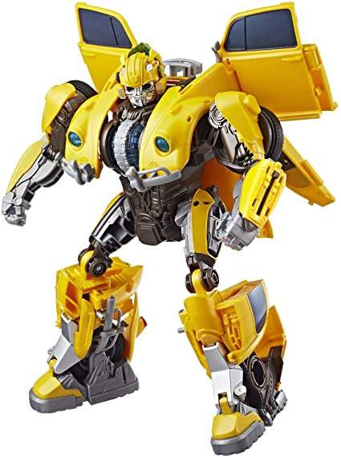
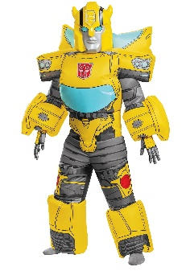
Pre-training: Two objectives
Pre-training on extracted Triples
Stanford OpenIE tool surely to return noisy Triples
We pretrain our Transformer on ‘Stanford’ Triples-pairs and finetune on WebNLG dataset.
A key advantage of using external corpora is our generalization on unseen categories (we hope)
Overall Training Framework
Denoising
Objective
(57M)
Stanford Triples-text pairs
WebNLG

Slide 16
The Transformer Model

Slide 17
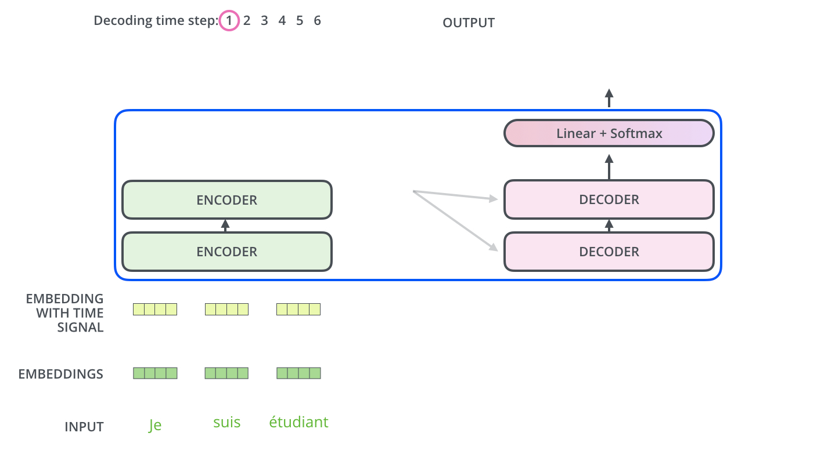
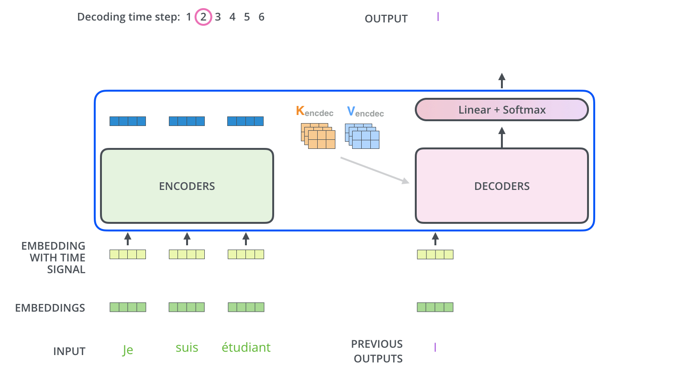
Transformer Model

Slide 18
18
Training setting
Concatenation of the triplets → Input sequence
Special tokens for <object> <subject> <predicate> <eot>
Moses + BPE tokenization
<subject> Abner ( footballer ) <predicate> birth Date <object> 199@@ 6-0@@ 5-@@ 30 <eot>
Transformer base architecture¹
dictionnary size : 4k tokens → 46 millions parameters
Finetuning with WebNLG data on pre-trained models
Curriculum learning :
→ for 30 epochs, the order of training samples doesn’t change, the easiest first
4 GPUs ~ 1h30
1. Vaswani, Ashish, et al. "Attention is all you need." Advances in neural information processing systems. 2017.

Slide 19
Evaluation Metric
BLEU score
N-gram based metric
Compare the number of n-gram overlaps between the prediction and the references
Advantages:
Automatic metric
Can be computed easily
Correlates with Human judgement
Drawbacks:
Parameterized metric : values can vary wildly (3-grams, 4-grams? # of references used)
Correlates poorly with Human judgement
Is a prediction with BLEU score of 45.3 better than 45.6 ?
Human annotations remains the optimal evaluation for Natural Language Generation !

Slide 20
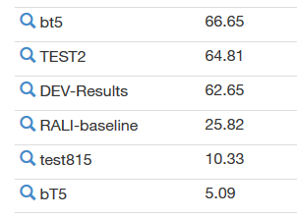
Our (dev) Results
Data | Curriculum Learning | (multi-) BLEU
WebNLG |  | 64.65
 |  | 64.46
Stanford + WebNLG |  | 65.35
 |  | 66.34
Denoising + WebNLG |  | 65.54
 |  | 65.76
Denoising + Stanford + WebNLG |  | 66.23
 |  | 66.79
Submissions are evaluated manually !

Slide 21
Our Results
Data | Curriculum Learning | BLEU (seen categories) | BLEU (unseen categories)
WebNLG |  | 55.24 | 11.17
 |  | 54.78 | 12.45
Stanford + WebNLG |  | 59.32 | 23.26
 |  | 58.36 | 22.84
Denoising + WebNLG |  | 57.3 | 21.02
 |  | 56.94 | 21.84
Denoising + Stanford + WebNLG |  | 57.49 | 23.42
 |  | 58.81 | 22.72
Submissions are evaluated manually !

Slide 22
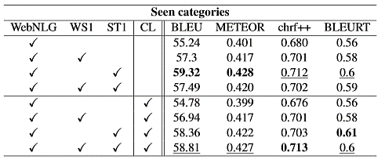
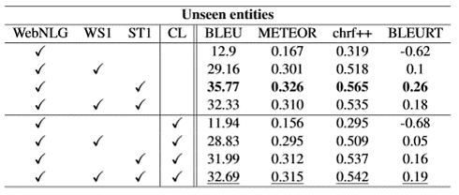
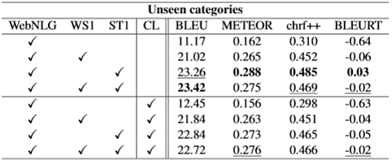
(More) Results
Minimum relative increases of 3.73%, 126.05% and 88.16% in BLEU score for seen categories, unseen entities and unseen categories respectively over our baseline with pre-training.

Slide 23
Thank you
Q&A
Notes:
Talk about the results (automatic results: 5-8 October / Human Evaluation: Oct- December)

